Slide 1
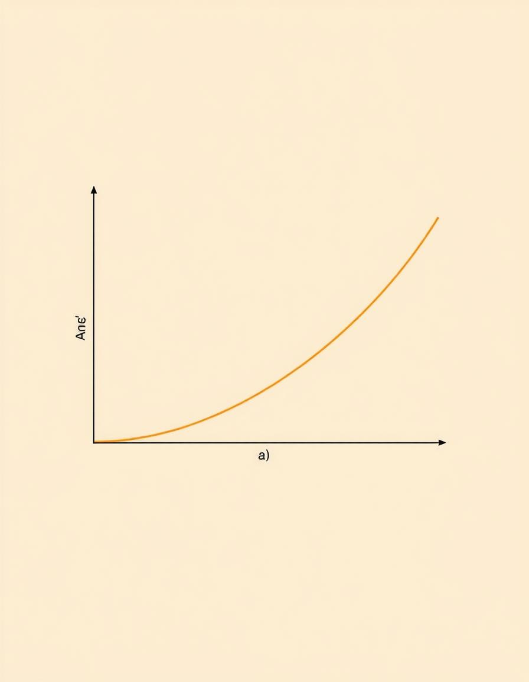
The Bisection Method: Finding Roots in ML Loss Gradients
A Deep Dive for Data Science Students & Practitioners

Slide 2






Presentation Agenda
Logistic Regression Essentials
Data Preparation & Features
Understanding the sigmoid function and log-loss.
Loading, preprocessing, and feature engineering.
Loss & Gradient Functions
Bisection Method Explained
Mathematical foundations and implementation.
Algorithm, convergence, and practical application.
Optimization Results & Insights
Model Evaluation
Visualizing convergence, parameters, and decision boundaries.
Accuracy, confusion matrices, and performance metrics.

Slide 3

Data Loading & Preprocessing
We prepare our synthetic dataset for logistic regression by loading it, applying standard scaling to normalize feature values, and adding a bias term. This ensures numerical stability and helps optimize the model efficiently.
https://www.kaggle.com/datasets/mohammedsakibhasan3/synthetic-dataset
import numpy as np, pandas as pd
from sklearn.preprocessing import StandardScaler
# Load data
df = pd.read_csv("smote_synthetic_data.csv")
X, y = df[['feature1','feature2']].values, df['y'].values
# Add noise, scale, add bias
np.random.seed(42)
X = X + 0.8 * np.random.randn(*X.shape)
X = StandardScaler().fit_transform(X)
X_b = np.c_[np.ones(X.shape[0]), X]
print("Dataset shape (with bias):", X_b.shape)
print("Target shape:", y.shape)
Output:
Dataset loaded: 1000 samples
Added feature noise (std=0.8) and label noise (12.0%)
Class distribution after noise:
Class 0: 504 samples
Class 1: 496 samples
Feature range: [-3.195, 8.881]
Labels flipped: 120 out of 1000 (12.0%)

Slide 4
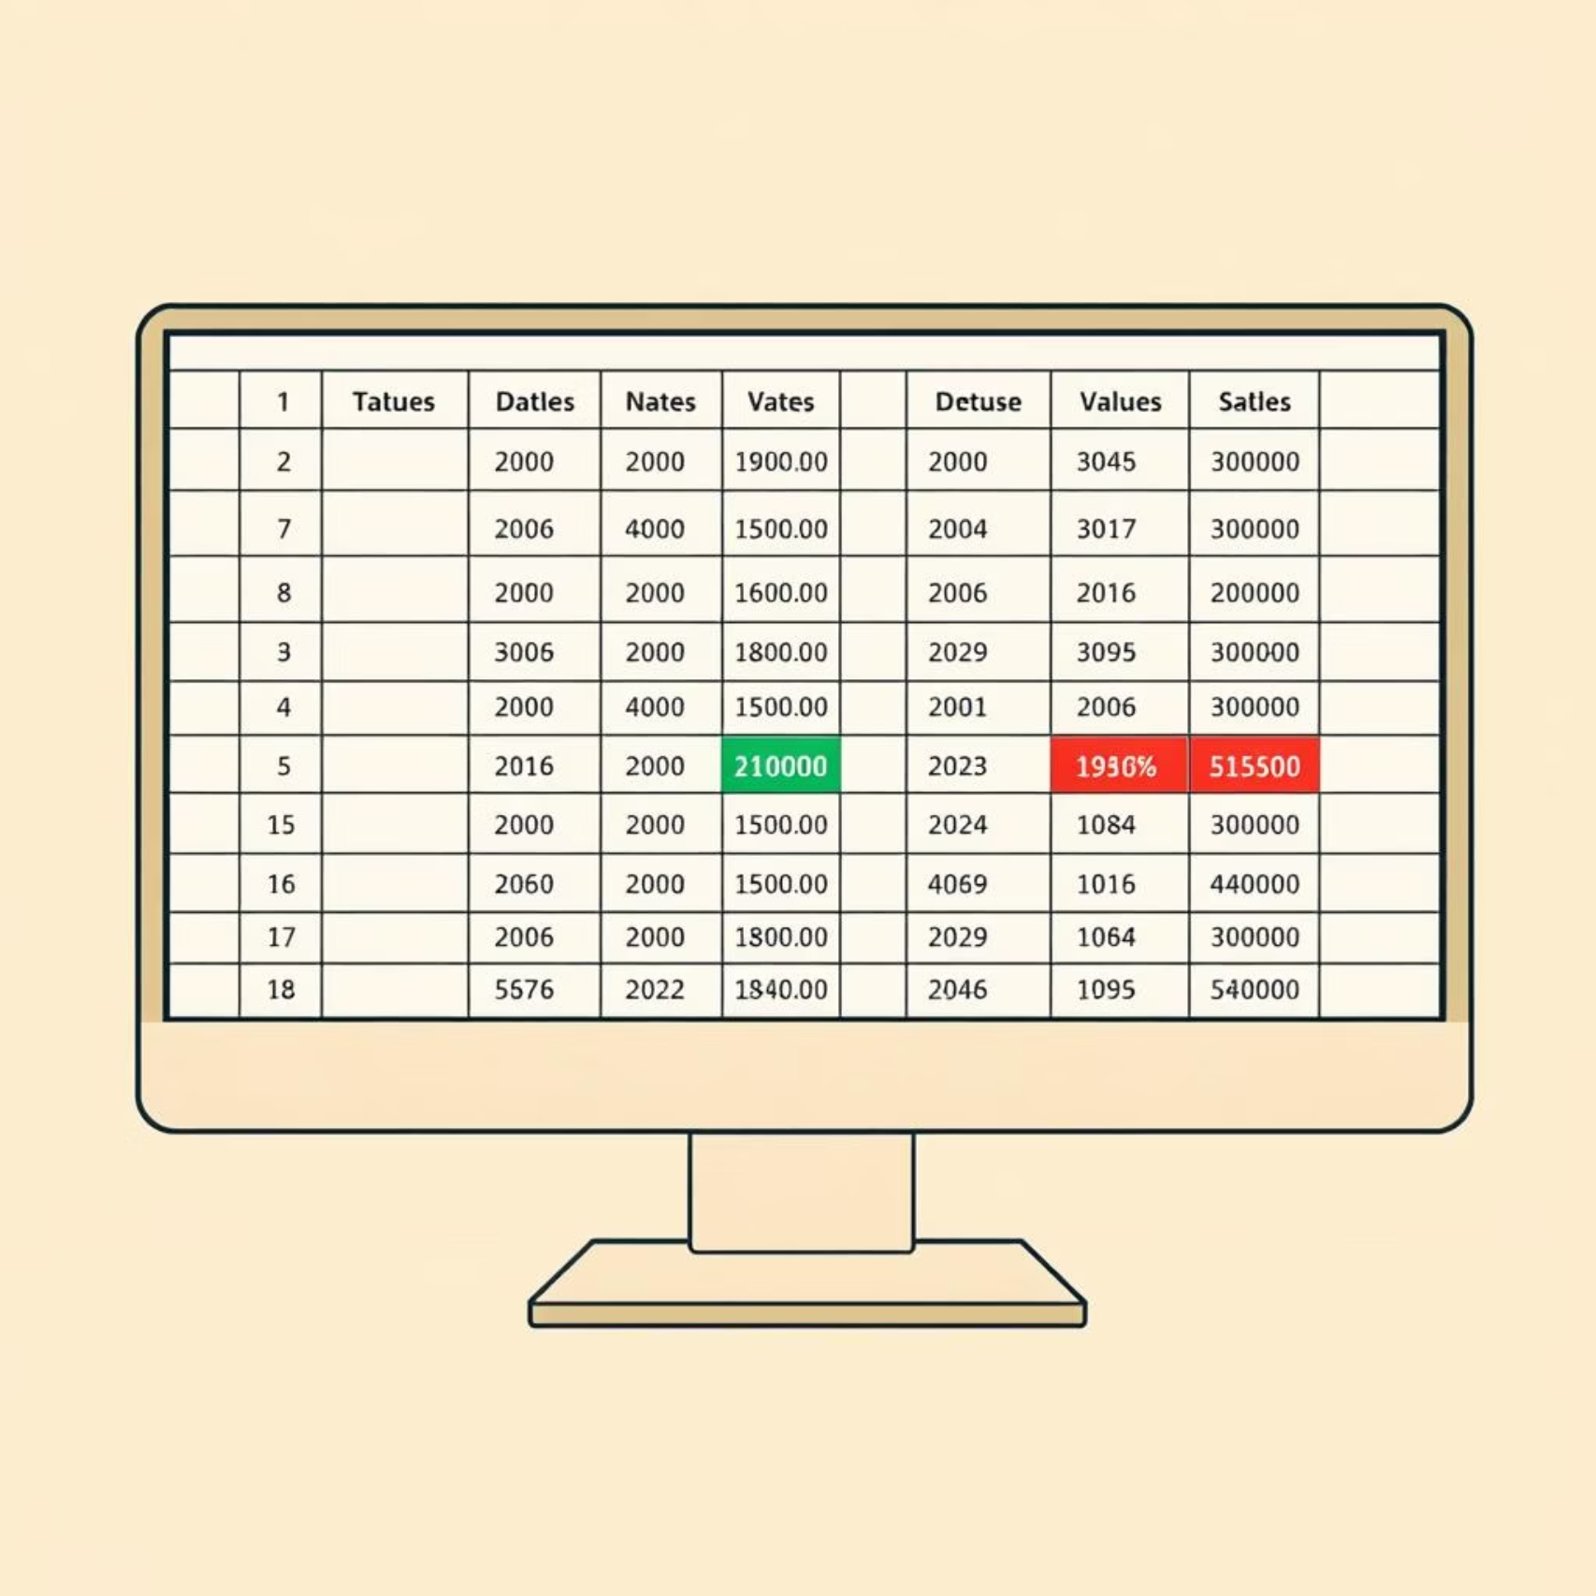
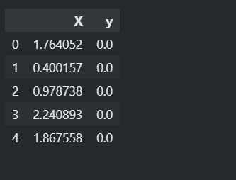
Data Quality: Handling Missing Values & Duplicates
Before training our model, it's essential to ensure the quality of our data. We perform a quick check for null values to identify and handle any missing data points that could affect model performance. Additionally, we verify for duplicate rows to maintain data integrity and uniqueness, and use df.head() to get a glimpse of the dataset's structure.
df.head()
print(f"Total duplicate rows: {df.duplicated().sum()}")
df.isnull().sum()
Output:

Slide 5
Loss and Gradient Functions
The core of our optimization lies in correctly computing the loss and its gradient. The gradient tells us the direction of steepest ascent of the loss function, so we move in the opposite direction (gradient descent) to minimize it.
Loss Function (Log-Loss)
Gradient Function
This function measures how well our current weights w explain the observed labels y.
The gradient provides the direction and magnitude of the steepest increase in loss. We use this to update our weights during optimization.
def sigmoid(z):
z = np.clip(z, -500, 500)
return 1 / (1 + np.exp(-z))
def logloss(w, b=0):
p = sigmoid(w * X + b)
p = np.clip(p, 1e-15, 1 - 1e-15)
return -np.mean(y * np.log(p) + (1 - y) * np.log(1 - p))
def grads(w, b=0):
e = sigmoid(w * X + b) - y
return np.mean(e * X), np.mean(e) # dL/dw, dL/db
def bisect_root(f, a, b, tol=1e-6, max_iter=1000):
fa, fb = f(a), f(b)
if fa * fb > 0: raise ValueError("No sign change on [a,b].")
for _ in range(max_iter):
c = (a + b) / 2; fc = f(c)
if abs(fc) < tol or (b - a) / 2 < tol: return c
if fa * fc < 0: b, fb = c, fc
else: a, fa = c, fc
return (a + b) / 2
Output:
Initial Loss: 0.6931Initial Gradient: [ 0.00000000e+00 -1.13961186e-17 -1.22124534e-17]

Slide 6

Find optimal weight without Bisection Method
We'll now apply the Bisection Method to find the optimal weight (w) for our logistic regression model, focusing on the point where the gradient of the loss function is zero. We'll start by optimizing for a single weight parameter, keeping the bias term fixed at zero for simplicity.
First, find the optimal weight 'w' (keeping bias = 0)
print("Bisection: ML loss gradient")
try:
w = bisection_root(lambda w: logistic_grad(w), -10, 10)
except ValueError as e:
print("Bisection failed:", e); w = 1.0
loss = logistic_loss(w)
acc = ((sigmoid(w * X) >= 0.5).astype(int) == y).mean()
print(f"w*: {w:.6f}\nloss: {loss:.6f}\naccuracy (no bias): {acc:.4f} ({acc*100:.2f}%)")
Output from executing the bisection method:

Slide 7

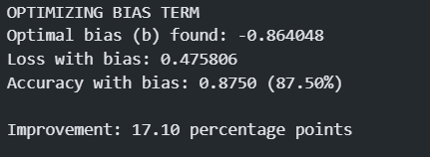
Calculate accuracy with bias
print("Bisection: optimize bias")
try:
b_root = bisection_root(lambda b: logistic_grad_bias(w_root, b), -10, 10)
except ValueError as e:
print("Bisection failed:", e); b_root = 0.0
loss_b = logistic_loss(w_root, b_root)
acc_with_bias = ((sigmoid(w_root * X + b_root) >= 0.5).astype(int) == y).mean()
print(f"b*: {b_root:.6f}\nloss: {loss_b:.6f}\naccuracy (with bias): {acc_with_bias:.4f} ({acc_with_bias*100:.2f}%)")
print(f"Δacc: {(acc_with_bias - acc_no_bias)*100:.2f} pp")
Output from executing the bisection method:

Slide 8
The Bisection Method for Optimization
The bisection method is a root-finding algorithm that can be adapted for optimization. By finding where the gradient is zero, we can locate the minimum of a convex function. For logistic regression, the loss function is convex, making bisection a viable, albeit slower, approach for specific scenarios like finding optimal learning rates or for pedagogical demonstration of convex optimization.
01
02
03
1. Define Interval
2. Calculate Midpoint
3. Evaluate Gradient
Choose an initial interval [a, b] where the minimum is expected to lie, such that the derivative (gradient in our case) changes sign within this interval.
Compute the midpoint c = (a + b) / 2.
Calculate the gradient at the midpoint, ∇L(c).
04
05
4. Halve the Interval
5. Repeat & Converge
If ∇L(c) is positive, the minimum is in [a, c]. Set b = c.
Continue iterating until the interval width (b - a) is smaller than a predefined tolerance, or a maximum number of iterations is reached. The midpoint of the final interval approximates the optimal solution.
If ∇L(c) is negative, the minimum is in [c, b]. Set a = c.

Slide 9
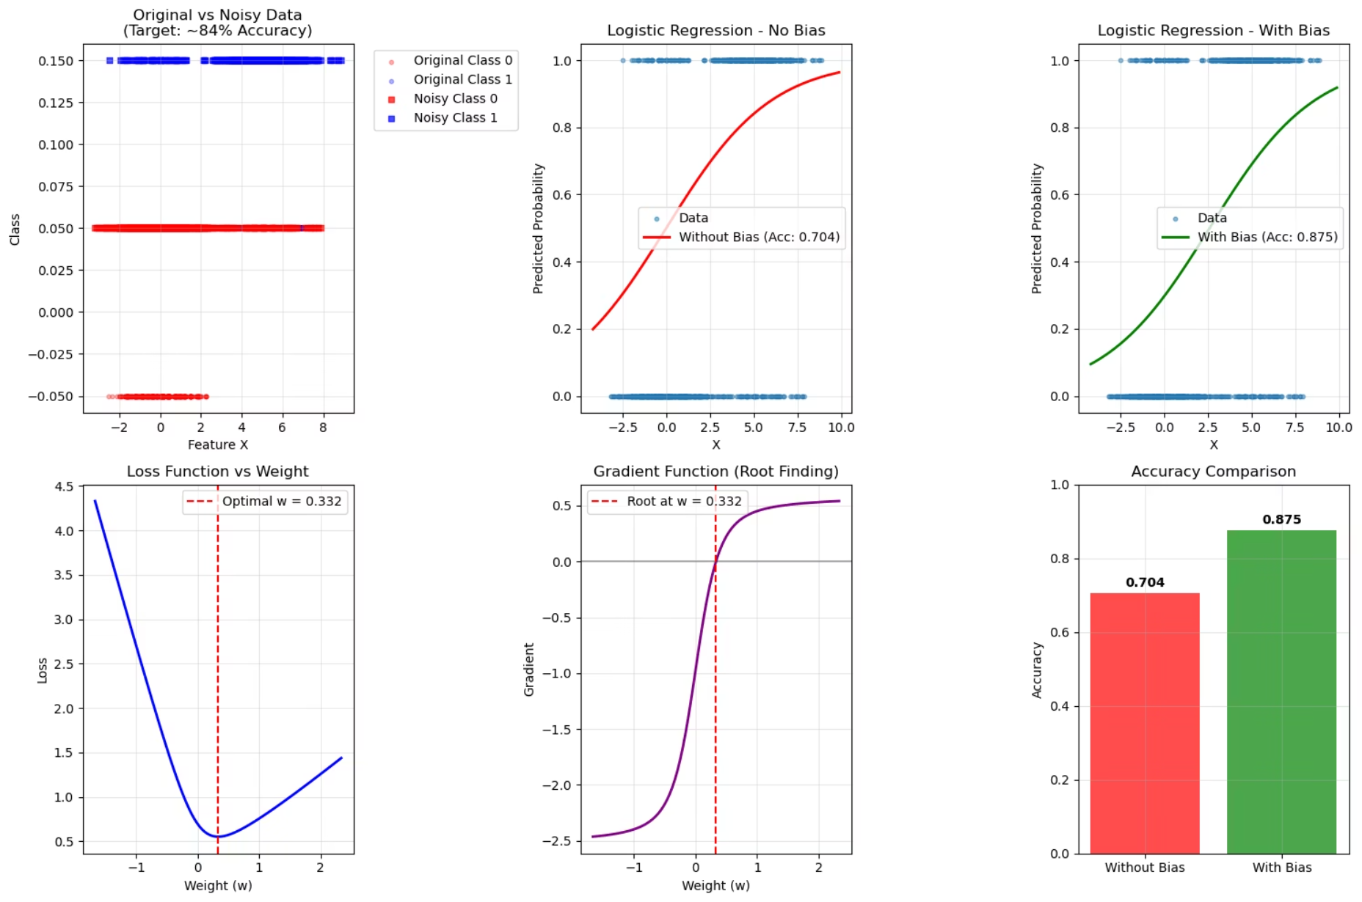
Optimization Results: Loss & Interval Width
Monitoring the loss function and the interval width provides critical diagnostics during the bisection optimization. As iterations progress, we expect the loss to decrease, indicating convergence towards the minimum, while the interval width rapidly shrinks, affirming the method's precision.
Loss vs. Iterations

Slide 10
Model Evaluation & Performance
After the bisection method converged, we obtained the optimal parameters and evaluated the model's performance using key metrics.
0.332
-0.864
87.50%
0.476
Optimal Weight (w)
Optimal Bias (b)
Final Accuracy
Final Loss
The learned coefficient for feature 1.
The learned intercept term of the model.
The percentage of correctly classified samples.
The minimized log-loss value after optimization.
The final logistic regression model's decision boundary can be represented by the following equation:

Slide 11


Summary & Key Takeaways
Foundational Understanding
Grasped the core principles of logistic regression, including the sigmoid function and log-loss, essential for binary classification.
Precision in Optimization
Explored the bisection method as a robust, albeit iterative, technique for finding the optimal parameters by converging on the zero-gradient point.
Practical Application
Successfully implemented and applied logistic regression to a synthetic dataset, demonstrating data preparation, loss, and gradient computations.
Insightful Visualization
Visualized key aspects of the optimization process, including loss convergence, interval reduction, decision boundaries, and learned coefficients, providing clear insights into model behavior.
Comprehensive Evaluation
Evaluated model performance using a full suite of metrics (accuracy, precision, recall, F1-score) and the confusion matrix, offering a holistic view of predictive capability.

